Slide 1

Gifted to Grow,
The Way God Grows
His Church
Ephesians 4:15-16

Slide 2
Ephesians 4:15-16 (CSB)
¹⁵ But speaking the truth in love, let us grow in every way into him who is the head—Christ.

Slide 3
Ephesians 4:15-16 (CSB)
¹⁶ From him the whole body, fitted and knit together by every supporting ligament, promotes the growth of the body for building itself up in love by the proper working of each individual part.

Slide 4
God Has a Pattern for Church Growth, It Still Works Today
Acts 2:41-47 (CSB)

Slide 5
Acts 2:41-47 (CSB)
⁴¹ So those who accepted his message were baptized, and that day about three thousand people were added to them. ⁴² They devoted themselves to the apostles’ teaching, to the fellowship, to the breaking of bread, and to prayer.

Slide 6
Acts 2:41-47 (CSB)
⁴³ Everyone was filled with awe, and many wonders and signs were being performed through the apostles. ⁴⁴ Now all the believers were together and held all things in common.

Slide 7
Acts 2:41-47 (CSB)
⁴⁵ They sold their possessions and property and distributed the proceeds to all, as any had need. ⁴⁶ Every day they devoted themselves to meeting together in the temple, and broke bread from house to house.

Slide 8
Acts 2:41-47 (CSB)
They ate their food with joyful and sincere hearts, ⁴⁷ praising God and enjoying the favor of all the people. Every day the Lord added to their number those who were being saved.

Slide 9
Growth Happens When Every Member Uses Their Spiritual Gift
Romans 12:1-8 (KJV)

Slide 10
Romans 12:1-8 (KJV)
¹ I beseech you therefore, brethren, by the mercies of God, that ye present your bodies a living sacrifice, holy, acceptable unto God, which is your reasonable service. ² And be not conformed to this world:

Slide 11
Romans 12:1-8 (KJV)
but be ye transformed by the renewing of your mind, that ye may prove what is that good, and acceptable, and perfect, will of God.

Slide 12
Romans 12:1-8 (KJV)
³ For I say, through the grace given unto me, to every man that is among you, not to think of himself more highly than he ought to think; but to think soberly, according as God hath dealt to every man the measure of faith.

Slide 13
Romans 12:1-8 (KJV)
⁴ For as we have many members in one body, and all members have not the same office: ⁵ So we, being many, are one body in Christ, and every one members one of another. ⁶ Having then gifts differing according to the grace that is given to us,

Slide 14
Romans 12:1-8 (KJV)
whether prophecy, let us prophesy according to the proportion of faith; ⁷ Or ministry, let us wait on our ministering: or he that teacheth, on teaching;

Slide 15
Romans 12:1-8 (KJV)
⁸ Or he that exhorteth, on exhortation: he that giveth, let him do it with simplicity; he that ruleth, with diligence; he that sheweth mercy, with cheerfulness.

Slide 16
Organization Is Not Unspiritual; It’s Biblical and Releases Spiritual Power
Titus 1:5 (CSB)
Acts 6:1-7 (CSB)

Slide 17
Titus 1:5 (CSB)
The reason I left you in Crete was to set right what was left undone and, as I directed you, to appoint elders in every town.

Slide 18
Acts 6:1-7 (CSB)
¹ In those days, as the disciples were increasing in number, there arose a complaint by the Hellenistic Jews against the Hebraic Jews that their widows were being overlooked in the daily distribution.

Slide 19
Acts 6:1-7 (CSB)
² The Twelve summoned the whole company of the disciples and said, “It would not be right for us to give up preaching the word of God to wait on tables.

Slide 20
Acts 6:1-7 (CSB)
³ Brothers and sisters, select from among you seven men of good reputation, full of the Spirit and wisdom, whom we can appoint to this duty. ⁴ But we will devote ourselves to prayer and to the ministry of the word.”

Slide 21
Acts 6:1-7 (CSB)
⁵ This proposal pleased the whole company. So they chose Stephen, a man full of faith and the Holy Spirit, and Philip, Prochorus, Nicanor, Timon, Parmenas, and Nicolaus, a convert from Antioch.

Slide 22
Acts 6:1-7 (CSB)
⁶ They had them stand before the apostles, who prayed and laid their hands on them. ⁷ So the word of God spread, the disciples in Jerusalem increased greatly in number, and a large group of priests became obedient to the faith.

Slide 23
Spiritual Gifts Point You to Your Place in the Church

Slide 24
EVANGELISM | EDUCATION | SERVICE | WORSHIP | FELLOWSHIP
Preaching | Adult | Grounds Keeping | Visitor Welcome | Meal Provision
World Bible School | Female Youth | Facility Maintenance | Song Leading | Event Planning
In Home Class | Male Youth | Construction | Prayers | Lightpost App
Public Speaking | New Convert | Electrical | Communion | Youth Group
Material Development | Small Children | Plumbing | IT | Bulletin Board
Mission Work | Adult Sisters | Safety | Usher | Benevolence
Outreach Plan | Men’s Training | Administrative | Preparation | Church Liaison

Slide 25
A Committed Unified Church is a Growing Church
Philippians 1:27 (KJV)
Nehemiah 2:17–18 (CSB)

Slide 26
Philippians 1:27 (KJV)
Only let your conversation be as it becometh the gospel of Christ: that whether I come and see you, or else be absent, I may hear of your affairs, that ye stand fast in one spirit, with one mind striving together for the faith of the gospel;

Slide 27
Nehemiah 2:17–18 (CSB)
¹⁷ So I said to them, “You see the trouble we are in. Jerusalem lies in ruins and its gates have been burned. Come, let’s rebuild Jerusalem’s wall, so that we will no longer be a disgrace.”

Slide 28
Nehemiah 2:17–18 (CSB)
¹⁸ I told them how the gracious hand of my God had been on me, and what the king had said to me. They said, “Let’s start rebuilding,” and their hands were strengthened to do this good work.

Slide 29
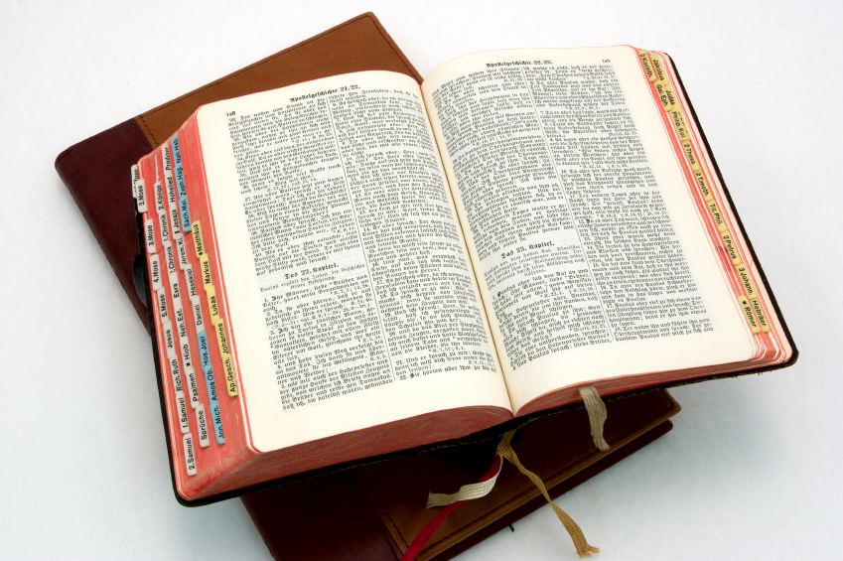
Hear: Romans 10:17
So then faith cometh by hearing, and hearing by the word of God.

Slide 30
Believe: Hebrews 11:6
But without faith it is impossible to please him: for he that cometh to God must believe that he is, and that he is a rewarder of them that diligently seek him.

Slide 31
Repent: Luke 13:3
I tell you, Nay: but, except ye repent, ye shall all likewise perish.

Slide 32
Confess: Matthew 10:32-33
32 Whosoever therefore shall confess me before men, him will I confess also before my Father which is in heaven.
33 But whosoever shall deny me before men, him will I also deny before my Father which is in heaven.

Slide 33
Baptize: Acts 22:16
And now why tarriest thou? arise, and be baptized, and wash away thy sins, calling on the name of the Lord.

